Slide 1

Intel 8086
An Introduction

Slide 2
Intel 8086 CPU: An Introduction
8086 Features
16-bit Arithmetic Logic Unit
• 16-bit data bus
• 20-bit address bus - 2²⁰ = 1,048,576 = 1 meg
The address refers to a byte in memory. In the 8086, bytes at even addresses come in on the low half of the data bus (bits 0-7) and bytes at odd addresses come in on the upper half of the data bus (bits 8-15).
The 8086 can read a 16-bit word at an even address in one operation and at an odd address in two operations.
The least significant byte of a word on an 8086 family microprocessor is at the lower address.

Slide 3
8086 Architecture
  • The 8086 has two parts, the Bus Interface Unit (BIU) and the
  Execution Unit (EU).
  • The BIU fetches instructions, reads and writes data, and computes the
  20-bit address.
  • The EU decodes and executes the instructions using the 16-bit ALU.
  • The BIU contains the following registers:
    IP - the Instruction Pointer
    CS - the Code Segment Register
    DS - the Data Segment Register
    SS - the Stack Segment Register
    ES - the Extra Segment Register
The BIU fetches instructions using the CS and IP, written CS:IP, to construct
the 20-bit address. Data is fetched using a segment register (usually the DS)
and an effective address (EA) computed by the EU depending on the
addressing mode.

Slide 4
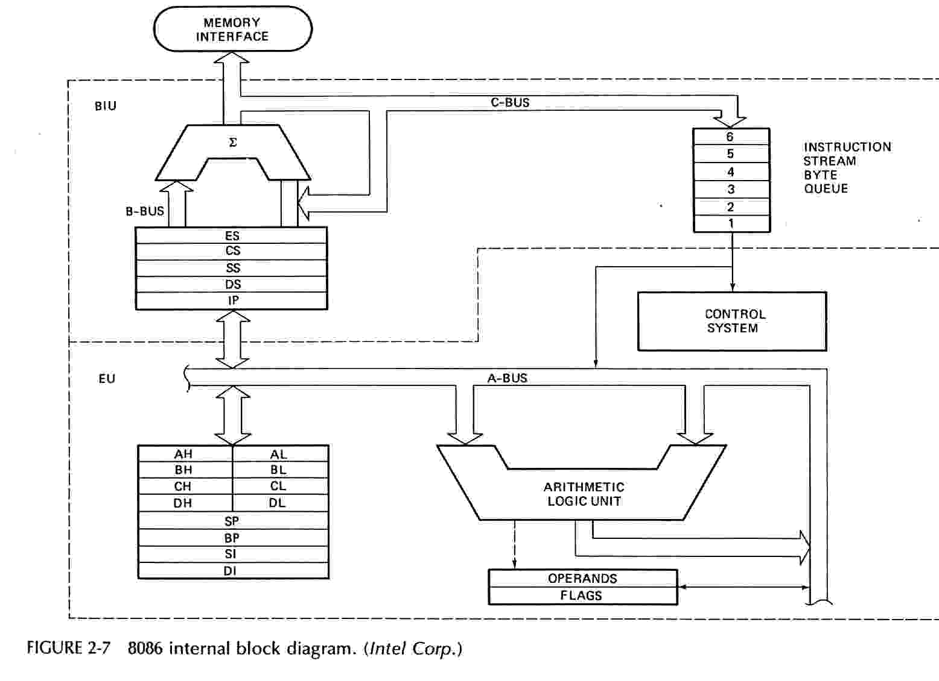
8086 Block Diagram

Slide 5
8086 Architecture ]
The EU contains the following 16-bit registers:
        AX - the Accumulator
        BX - the Base Register
        CX - the Count Register
        DX - the Data Register
        SP - the Stack Pointer
        BP - the Base Pointer
        SI - the Source Index Register
        DI - the Destination Register
These are referred to as general-purpose registers, although, as seen by their names, they often have a special-purpose use for some instructions.
The AX, BX, CX, and DX registers can be considered as two 8-bit registers, a High byte and a Low byte. This allows byte operations and compatibility with the previous generation of 8-bit processors, the 8080 and 8085. The 8-bit registers are:
        AX --> AH,AL
        BX --> BH,BL
        CX --> CH,CL
        DX --> DH,DL
Default to stack segment

Slide 6
8086 Architecture
The EU also contains the Flag Register which is a collection of condition
bits and control bits. The condition bits are set or cleared by the execution
of an instruction. The control bits are set by instructions to control some
operation of the CPU.
    Bit 0 - CF Carry Flag - Set by carry out of msb
    Bit 2 - PF Parity Flag - Set if result has even parity
    Bit 4 - AF Auxiliary Flag - for BCD arithmetic
    Bit 6 - ZF Zero Flag - Set if result is zero
    Bit 7 - SF Sign Flag = msb of result
    Bit 8 - TF Single Step Trap Flag
    Bit 9 - IF Interrupt Enable Flag
    Bit 10 - DF String Instruction Direction Flag
    Bit 11 - OF Overflow Flag
    Bits 1, 3, 5, 12-15 are undefined.

Slide 7
8086 Programmer’s Model
16-bit Registers
ES
Extra Segment
_{BIU registers}
_{(20 bit adder)}
CS
Code Segment
SS
Stack Segment
DS
Data Segment
IP
Instruction Pointer
AX
AH
AL
Accumulator
BX
BH
BL
Base Register
CX
CH
CL
Count Register
DX
DH
DL
Data Register
SP
Stack Pointer
BP
Base Pointer
_{EU registers}
_{16 bit arithmetic}
SI
Source Index Register
DI
Destination Index Register
FLAGS

Slide 8
Segments
Segment Starting address is segment register value shifted 4 place to the left.
MEMORY
Address
000000H
CODE
64K Data
Segment
STACK
DATA
EXTRA
← CS:0
64K Code
Segment
Segment
Registers
Segments are < or = 64K,
can overlap, start at an address
that ends in 0H.
0FFFFFH

Slide 9
8086 Memory Terminology
Memory Segments
Segment
Registers
000000H
001000H
DS:
0100H
DATA
10FFFH
0B2000H
SS:
0B200H
STACK
0C1FFFH
ES:
0CF00H
0CF000H
EXTRA
0DEFFFH
CS:
0FF00H
0FF000H
CODE
0FFFFFH
Segments are < or = 64K and can overlap.
Note that the Code segment is < 64K since 0FFFFFH is the highest address.

Slide 10
The Code Segment
_{000000H}
4000H
CS:
0400H
4056H
IP
0056H
CS:IP = 400:56
Logical Address
Left-shift 4 bits
Memory
0400
0
Segment Register
Offset
Physical or
Absolute Address
+
0056
_{0FFFFFH}
04056H
The offset is the distance in bytes from the start of the segment.
The offset is given by the IP for the Code Segment.
Instructions are always fetched with using the CS register.
The physical address is also called the absolute address

Slide 11
The Data Segment
_{000000H}
05C00H
DS:
05C0
05C50H
EA
0050
DS:EA
Memory
05C0
0
Segment Register
Offset
Physical Address
+
0050
_{0FFFFFH}
05C50H
Data is usually fetched with respect to the DS register.
The effective address (EA) is the offset.
The EA depends on the addressing mode.

Slide 12
Addressing Modes
Assembler directive, DW = Define Word
DATA1 DW 25H DATA1 is defined as a word (16-bit) variable, i.e., a memory location that contains 25H.
DATA2 EQU 20H DATA2 is not a memory location but a constant.
Direct Addressing
MOV AX,DATA1 [DATA1] → AX, the contents of DATA1 is put into AX.
The CPU goes to memory to get data. 25H is put in AX.
Immediate Addressing
MOV AX,DATA2 DATA2 = 20H → AX, 20H is put in AX.
Does not go to memory to get data.
Data is in the instruction.
MOV AX, OFFSET DATA1 The offset of SAM is just a number.
The assembler knows which mode to encode by the way the operands SAM and FRED are defined.

Slide 13
Addressing Modes
Register Addressing MOV AX,BX AX
BX
Register Indirect Addressing
MOV AX,[BX] AX DS:BX
Can use BX or BP -- Based Addressing (BP defaults to SS)
or DI or SI -- Indexed Addressing
The offset or effective address (EA) is in the base or index register.
Register Indirect with Displacement MOV AX,SAM[BX]
Indexed with displacement
Based with displacement
AX DS:BX + Offset SAM
AX
DS:EA
where EA = BX + offset SAM
Based-Indexed Addressing MOV AX,[BX][SI] EA = BX + SI
Based-Indexed w/Displacement MOV AX,SAM[BX][DI]
EA = BX + DI + offset SAM

Slide 14
Addressing Modes
Branch Related Instructions
NEAR JUMPS and CALLS
Intrasegment
(CS does not change)
Direct -- IP relative displacement
new IP = old IP + displacement
Allows program relocation with
no change in code.
Indirect -- new IP is in memory or a register.
All addressing modes apply.
FAR
Intersegment Direct -- new CS and IP are encoded in
(CS changes) the instruction.
Indirect -- new CS and IP are in memory.
All addressing modes apply
except immediate and register.

Slide 15
Assembly Language
The Assembler is a program that reads the source program as data and translates the instructions into binary machine code. The assembler outputs a listing of the addresses and machine code along with the
source code and a binary file (object file) with the machine code.
Most assemblers scan the source code twice -- called a two-pass assembler.
  The first pass determines the locations of the labels or identifiers.
  The second pass generates the code.

Slide 16
Assembly Language
To locate the labels, the assembler has a location counter. This counts the number of bytes required by each instruction.
  When the program starts a segment, the location counter is zero.
  If a previous segment is re-entered, the counter resumes the count.
  The location counter can be set to any offset by the ORG directive.
In the first pass, the assembler uses the location counter to construct a symbol table which contains the offsets or values of the various labels.
The offsets are used in the second pass to generate operand addresses.

Slide 17
Instruction Set
adc Add with carry flag
add Add two numbers
and Bitwise logical AND
call Call procedure or function
cbw Convert byte to word (signed)
cli Clear interrupt flag (disable interrupts)
cwd Convert word to doubleword (signed)
cmp Compare two operands
dec Decrement by 1
div Unsigned divide
idiv Signed divide
imul Signed multiply
in Input (read) from port
inc Increment by 1
int Call to interrupt procedure

Slide 18
Instruction Set (Contd.)
iret Interrupt return
j?? Jump if ?? condition met
jmp Unconditional jump
lea Load effective address offset
mov Move data
mul Unsigned multiply
neg Two's complement negate
nop No operation
not One's complement negate
or Bitwise logical OR
out Output (write) to port
pop Pop word from stack
popf Pop flags from stack
push Push word onto stack

Slide 19
Instruction Set (Contd.)
pushf Push flags onto stack
ret Return from procedure or function
sal Bitwise arithmetic left shift (same as shl)
sar Bitwise arithmetic right shift (signed)
sbb Subtract with borrow
shl Bitwise left shift (same as sal)
shr Bitwise right shift (unsigned)
sti Set interrupt flag (enable interrupts)
sub Subtract two numbers
test Bitwise logical compare
xor Bitwise logical XOR

Slide 20
Conditional Jumps
Name/Alt Meaning Flag setting
JE/JZ Jump equal/zero ZF = 1
JNE/JNZ Jump not equal/zero ZF = 0
JL/JNGE Jump less than/not greater than or = (SF xor OF) = 1
JNL/JGE Jump not less than/greater than or = (SF xor OF) = 0
JG/JNLE Jump greater than/not less than or = ((SF xor OF) or ZF) = 0
JNG/JLE Jump not greater than/ less than or = ((SF xor OF) or ZF) = 1
JB/JNAE Jump below/not above or equal CF = 1
JNB/JAE Jump not below/above or equal CF = 0
JA/JNBE Jump above/not below or equal (CF or ZF) = 0
JNA/JBE Jump not above/ below or equal (CF or ZF) = 1
JS Jump on sign (jump negative) SF = 1
JNS Jump on not sign (jump positive) SF = 0
JO Jump on overflow OF = 1
JNO Jump on no overflow OF = 0
JP/JPE Jump parity/parity even PF = 1
JNP/JPO Jump no parity/parity odd PF = 0
JCXZ Jump on CX = 0 ---

Slide 21
More Assembler Directives
ASSUME Tells the assembler what segments to use.
SEGMENT Defines the segment name and specifies that the
        code that follows is in that segment.
ENDS End of segment
ORG Originate or Origin: sets the location counter.
END End of source code.
NAME Give source module a name.
DW Define word
DB Define byte.
EQU Equate or equivalence
LABEL Assign current location count to a symbol.
$ Current location count

Slide 22
?

